Slide 1
Warm Up March 4, 2016
Quiz
Today
Agenda
Warm Up
Review HW
Review for Quiz
Quiz
Solve for x.
5(3x + 2) = 130
2. Solve for x.
7x + 3(4 + 2x) = 51
15x + 10 = 130
-10 -10
15x = 120
15 15
x = 8
7x + 12 + 6x = 51
13x + 12 = 51
-12 -12
13x = 39
13 13
x = 3
HW: Worksheet

Slide 2
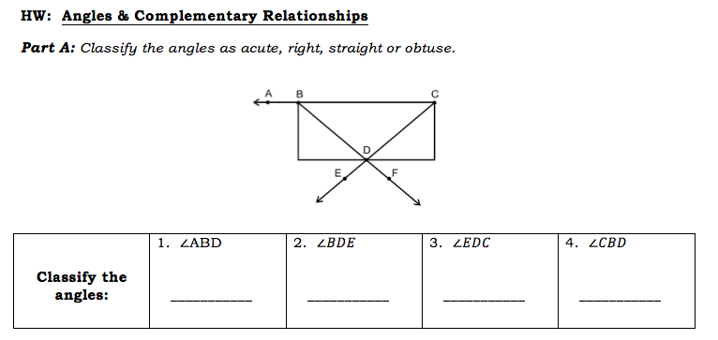
HW Answers for complementary angles
Obtuse
Right
Straight
Acute

Slide 3
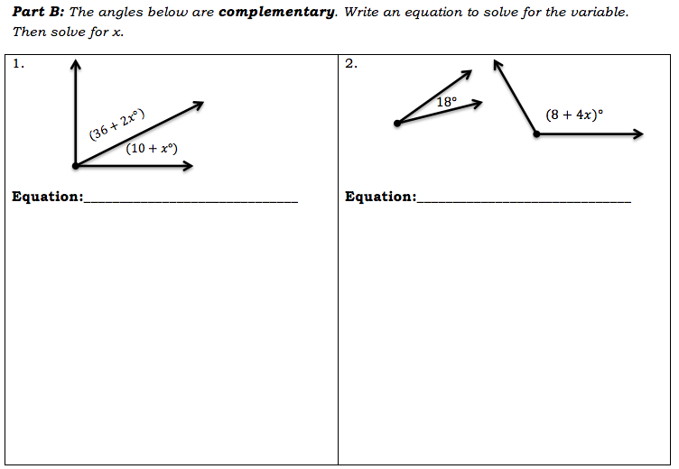
HW Answers
36 + 2x + 10 + x = 90
18 + 8 + 4x = 90
36 + 2x + 10 + 1x = 90
3x + 46 = 90
- 46 - 46
3x = 44
3 3
x = 14.6
18 + 8 + 4x = 90
4x + 26 = 90
- 26 - 26
4x = 64
4 4
x = 16

Slide 4
HW Answers for supplementary angles
2x + 3 + x + 9 = 90
3x + 12 = 90
- 12 - 12
3x = 78
3 3
x = 26
-5x + 10 = -5
-10 -10
-5x = -15
-5 -5
x = 3
7x + 29 + 5x – 5 = 90
12x + 24 = 180
- 24 - 24
12x = 156
12 12
x = 13
Substitute the value that you got for x back into each angle

Slide 5
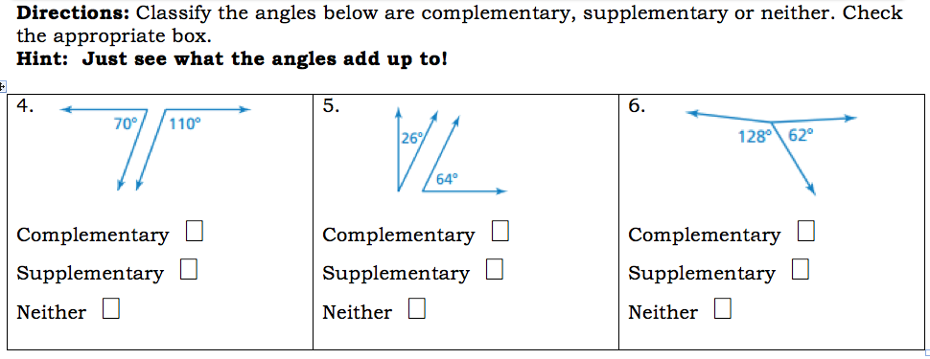
HW Answers for supplementary angles

Slide 6
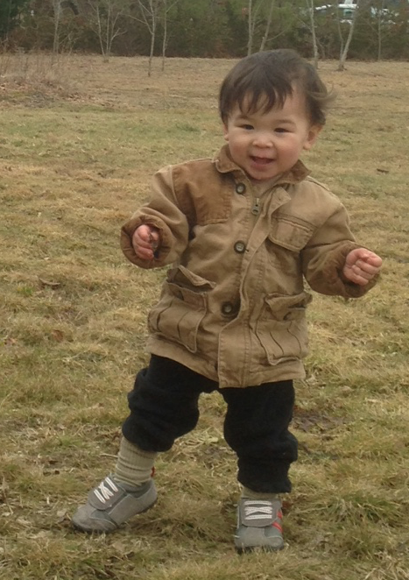
Review for Quiz
1. 9% when converted to a decimal is:
0.9
0.09
2. Gil’s birth weight was 10.4 pounds. A year later, his weight is 24 pounds. What is the percent of change of his weight?
Original: ________
New: ________
Round to the nearest percent.

Slide 7
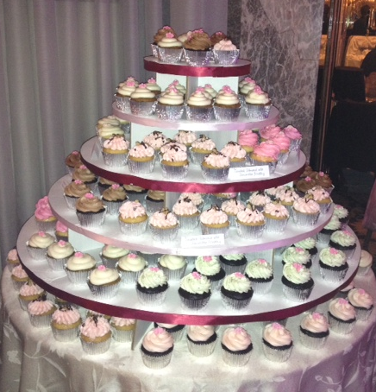
Review for Quiz
3. It costs $0.60 to make a cupcake. If a bakery marked up the cupcakes by 375%, what is the new selling price?
Mark-up = 375%(0.60)
= 3.75(0.60)
M = 2.25
Selling price = 0.60
+2.25
2.85

Slide 8
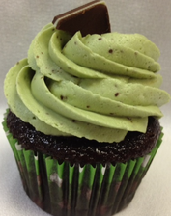
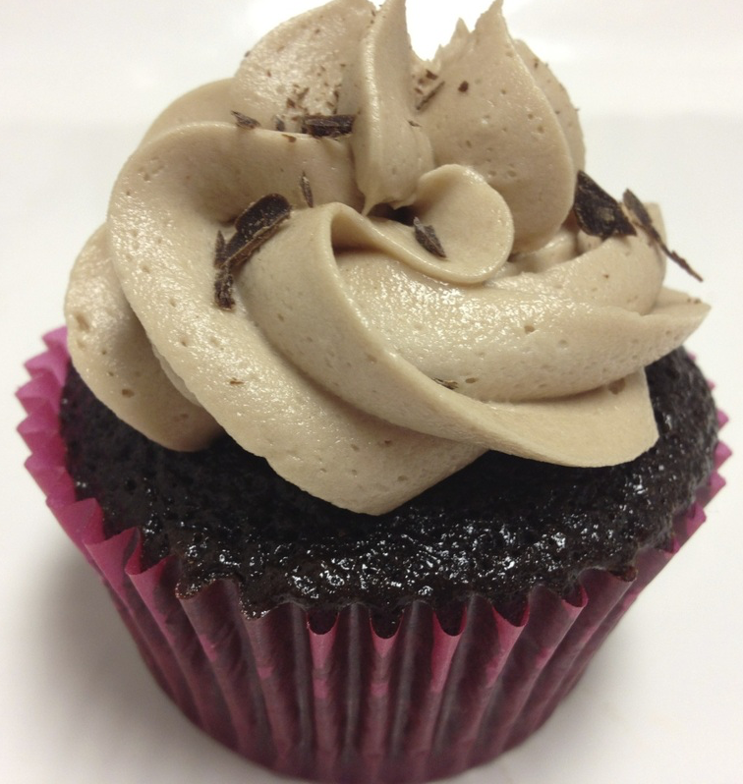
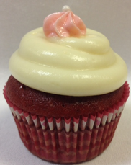
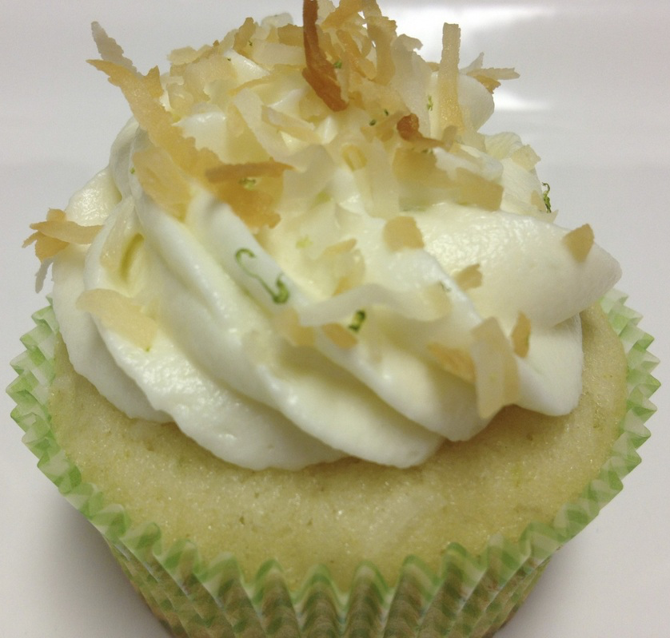
Review for Quiz
4. Ms. Nhotsoubanh took out a $250,000 loan to start a cupcake business. After 15 years, how much would she have to pay back if the interest rate is 4.5%?
I = PRT
? = (250,000)(0.045)(15)
I = 168,750
Total repayment = 250,000
+ 168,750
418,750
Total repayment is $418,750

Slide 9
What’s Your Angle?
Define complementary.
4. Match the diagram with it’s corresponding angle name.
The sum of the angles is 90°
complementary
right
obtuse
acute
straight
supplementary

Slide 10
What’s Your Angle?
5. Solve for x:
6. Solve for x:
30°
(18 + 4x)°
(2x + 3)°
(3x + 17)°
18 + 4x + 30 = 180
4x + 48 = 180
- 48 - 48
4x = 132
4 4
x = 33
2x + 3 + 3x + 17 = 90
5x + 20 = 90
- 20 - 20
5x = 70
5 5
x = 14

