Slide 1
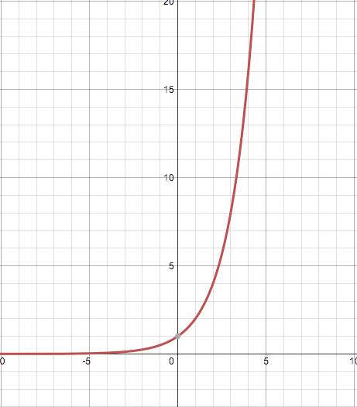
Warm-up March 31
1.) What is the domain of f(x)  2^{x} ?
1) all integers
2) all real numbers
3) x  0
4) x  0
2.) If the point (5, k) lies on the line represented by the equation 2x + y = 9, the value of k is
1) 1
2) 2
3) −1
4) −2
ANS: 3
2(5) + k = 9
10 + k = 9
k = −1

Slide 2
Functional Notation
Aim: You will be able to use function notation, evaluate functions for inputs in their domains, and interpret statements that use function notation in terms of a context.
1. If f(x) = |x³ – 3| then f−1 is equivalent to
1) 0
2) 2
3) −2
4) 4
|x³ – 3|
|(-1)³ – 3|
| -1 – 3|
| -4|
4

Slide 3
Functional Notation
If fx = what is the value of f−10?

Slide 4
Functional Notation
3. The graph of y = f(x) is shown below.
Which point could be used to find f(2)?
1) A 2) B
3) C 4) D
4. If fx = kx², and f2 = 12, then k equals
1) 1 2) 2 3) 3
4) 4
point A is located at (2, 0), f(2) = 0.
point B is located at (0, 2), f(0) = 2.
Point C is located at (-2, 0), f(-2) = 0.
Point D is located at (-1, -2), f(-1) = -2.
kx²
k(2)² = 12
4k = 12
4 4
k = 3

Slide 5
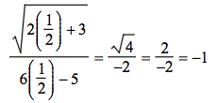
Functional Notation
5. If f(x) = , then f =
1) 1
2) −2
3) −1
4)
6. If fx = 2x² − 3x + 4, then fx + 3 is equal to
1) 2x² −3x + 7
2) 2x² − 3x + 13
3) 2x²+ 9x + 13
4) 2x²+ 9x + 25
2(x + 3)² – 3(x + 3) + 4
2(x² + 6x + 9) – 3x – 9 + 4
2x² + 12x + 18 – 3x – 9 + 4
2x² + 9x + 13

Slide 6
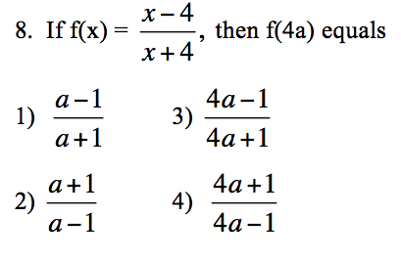
Functional Notation
7. The height, f(x), of a bouncing ball after x bounces is represented by
f(x) = 80(0.5)^{x} . How many times higher is the first bounce than the fourth bounce?
1) 8 2) 2
3) 16
4) 4
80(0.5)¹ = 40
80(0.5)⁴ = 5

Slide 7
Functional Notation

